Slide 1
Risk Management

Slide 2
Risk Assessment and Management
Effective risk management happens at two layers, as follows:
A security risk assessment evaluates threats to and vulnerabilities of the network
A business risk assessment evaluates the impact of potential threats on business processes

Slide 3
Risk Assessment and Management
A business process is a series of steps that accomplishes a defined goal
A vendor risk assessment (third-party risk assessment) evaluates security and compliance risks related to suppliers and vendors a company does business with
A posture assessment is a thorough examination of each aspect of the network to determine how it might be compromised
A security audit is an assessment performed by a company that has been accredited by an agency that sets network security standards

Slide 4
Attack Simulations (1 of 2)
During a posture assessment, you might use some of the methods a hacker uses to identify cracks in security architecture
There are three types of attack simulations:
A vulnerability assessment is used to identify vulnerabilities in a network
There are two types of assessments:
Authenticated – the attacker is given same access as a trusted user would have
Unauthenticated – the attacker begins on the perimeter of the network, looking for vulnerabilities that do not require trusted user privileges

Slide 5
Attack Simulations (1 of 2)
Pen (penetration) testing uses variable tools to find network vulnerabilities and attempts to exploit them
During a red team-blue team exercise, the red team conducts the attack, and the blue team attempts to defend the network

Slide 6
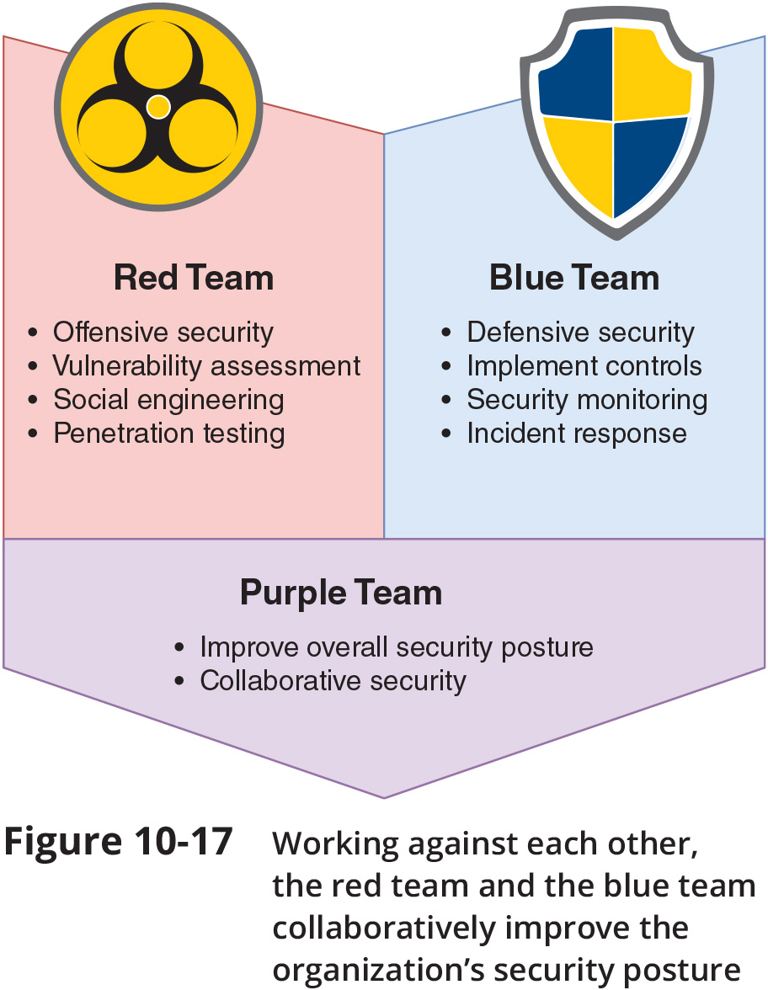
Attack Simulations (2 of 2)

Slide 7
Scanning Tools (1 of 3)
Scanning tools can be used to discover crucial information such as:
Every available host
Services, including applications and versions, running on every host
Software configurations
Open, closed, and filtered ports on every host
Existence, type, placement, and configuration of firewalls
Software configurations
Unencrypted or poorly encrypted sensitive data

Slide 8
Scanning Tools (2 of 3)
Three popular scanning tools include the following
NMAP – designed to scan large networks quickly and provide information about a network and its hosts
Nessus – performs more sophisticated scans than NMAP
Metasploit – combines known scanning and exploit techniques to explore potentially new attack routes

Slide 9
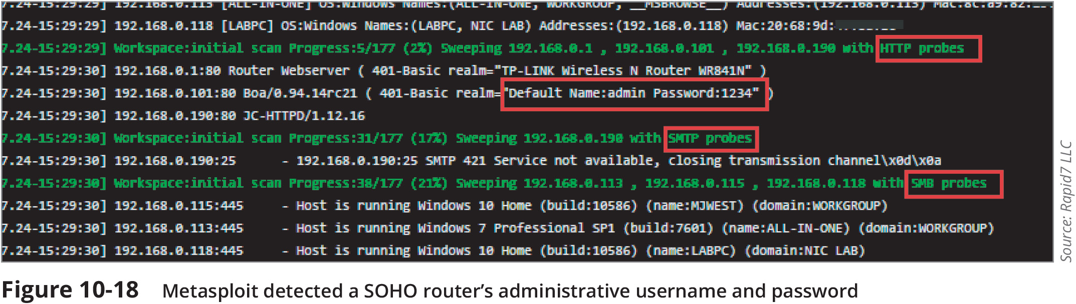
Scanning Tools (3 of 3)

Slide 10
Honeypots and Honeynets
A honeypot is a decoy system that is purposefully vulnerable
It is designed to fool hackers and gain information about their behaviour
A honeypot might be given an enticing name, such as one that indicates a name server or a storage location for confidential data
A honeynet is a network of honeypots

Slide 11
Physical Security
Physical access to critical components must be restricted and controlled
Only trusted networking staff should have access to secure computer/data rooms
Preventative measures such as locked doors can make it more difficult for unauthorised people to get into these areas
Important to have good detection measures in place for those times when someone is able to breach a secured perimeter

Slide 12
Prevention Methods (1 of 2)
Access control technologies include the following:
Keypad or cipher lock - cipher locks are physical or electronic locks requiring a code to open the door
Access badge – many organisations provide electronic access badges called smart cards
Biometrics – a device scans an individual’s unique physical characteristics

Slide 13
Prevention Methods (1 of 2)
Access control technologies include the following:
Access control vestibule – creates a confined space between two locked doors
Locking rack and locking cabinet – restrict physical access to servers, routers, switches, and firewalls installed on the rack to prevent an intruder from making configuration changes to these devices
Smart locker – allows controlled access to equipment, computers, packages, hardware in need of repair, or written account credentials stored for emergency access

Slide 14
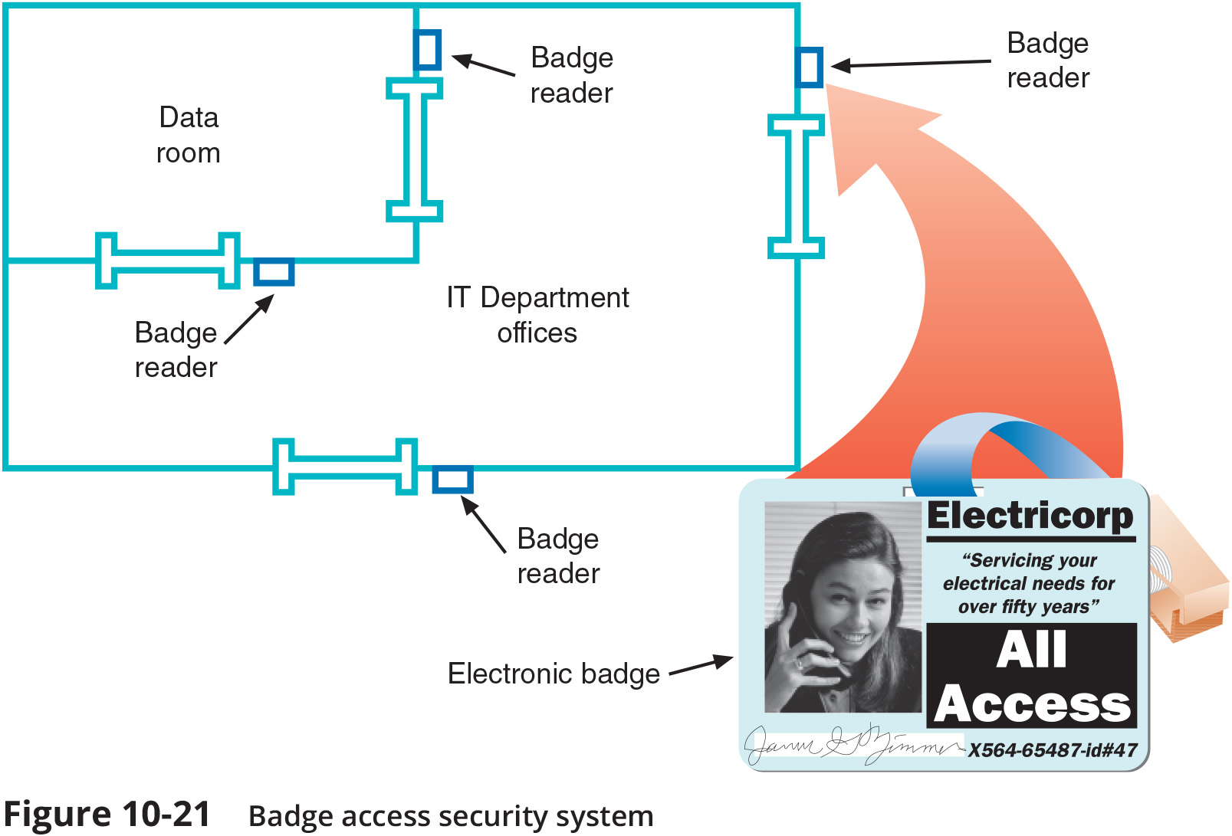
Prevention Methods (2 of 2)

Slide 15
Detection Methods (1 of 2)
Methods of detecting physical intrusions:
Motion detection
Cameras
Tamper detection – sensors that detect physical penetration, temperature extremes, input voltage variations, input frequency variations, or certain kinds of radiation
Asset tags – monitor the movement and condition of equipment, inventory, and people

Slide 16
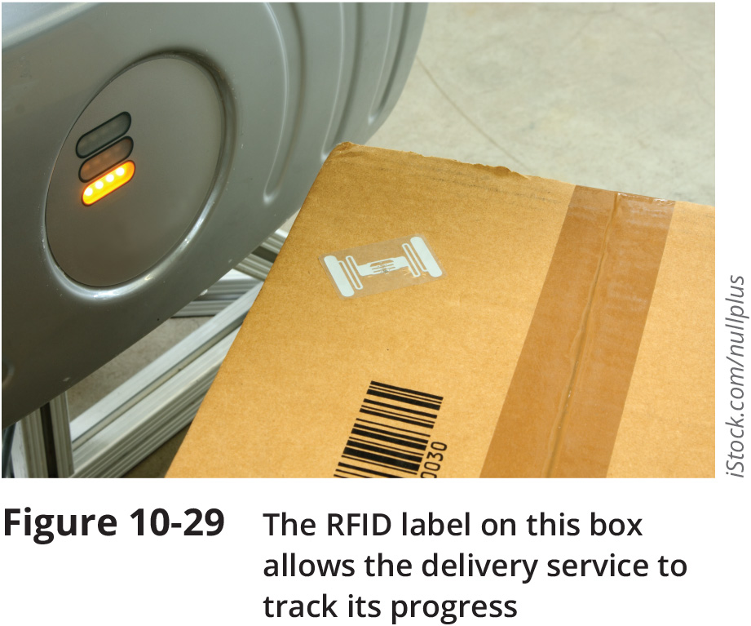
Detection Methods (2 of 2)

